Slide 1




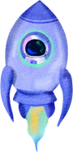







BEYOND
UFO
Jayla, Jeesoo, Ricky

Slide 2











Meet Our Team
Jayla Haskins
Jeesoo Jhun
Ricky Bocek

Slide 3

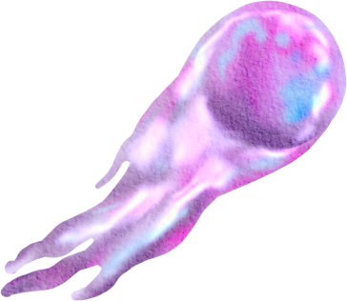


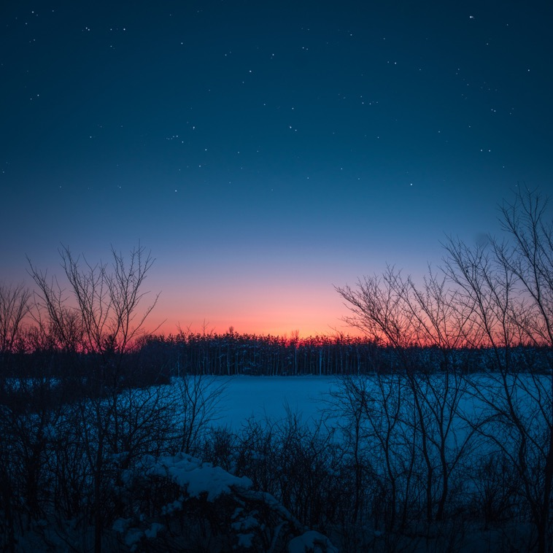


Contents
Overview
Data Understanding & Methods
Analysis & Results
- Regions, Timing, Shapes, Description
Insights & Recommendations
Conclusions

Slide 4
Overview
Objective:
Identify UFO patterns for Tourism, Government, and Research
2. Key Questions:
Where and When are sightings frequent?
Common Shapes and Descriptions?
Time/Season patterns?

Slide 5





Data
Understanding
UFO reports:
- Date, Time, Location, Shape, Duration
2. Key questions:
- Regional frequency, Patterns, Timing Correlations

Slide 6




Methods
1
Descriptive
- Region, time, shape
2
Correlation
- encounter duration vs. time of day
3
Tools
- Heatmaps, bar charts, distribution plots

Slide 7



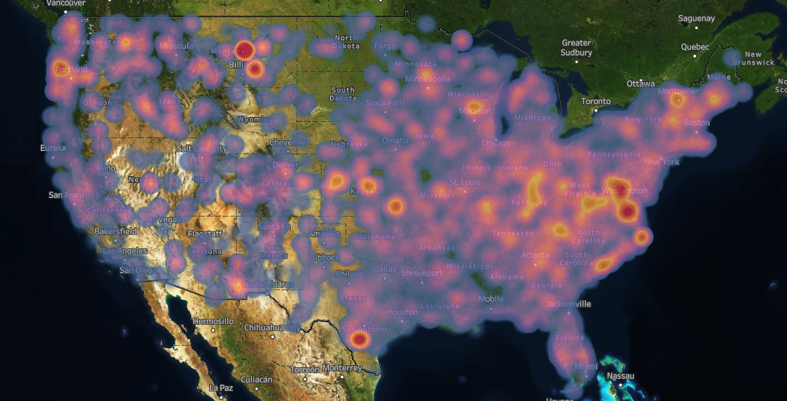



Region
Hot Zones:
Central Montana
DC Area
South Texas

Slide 8
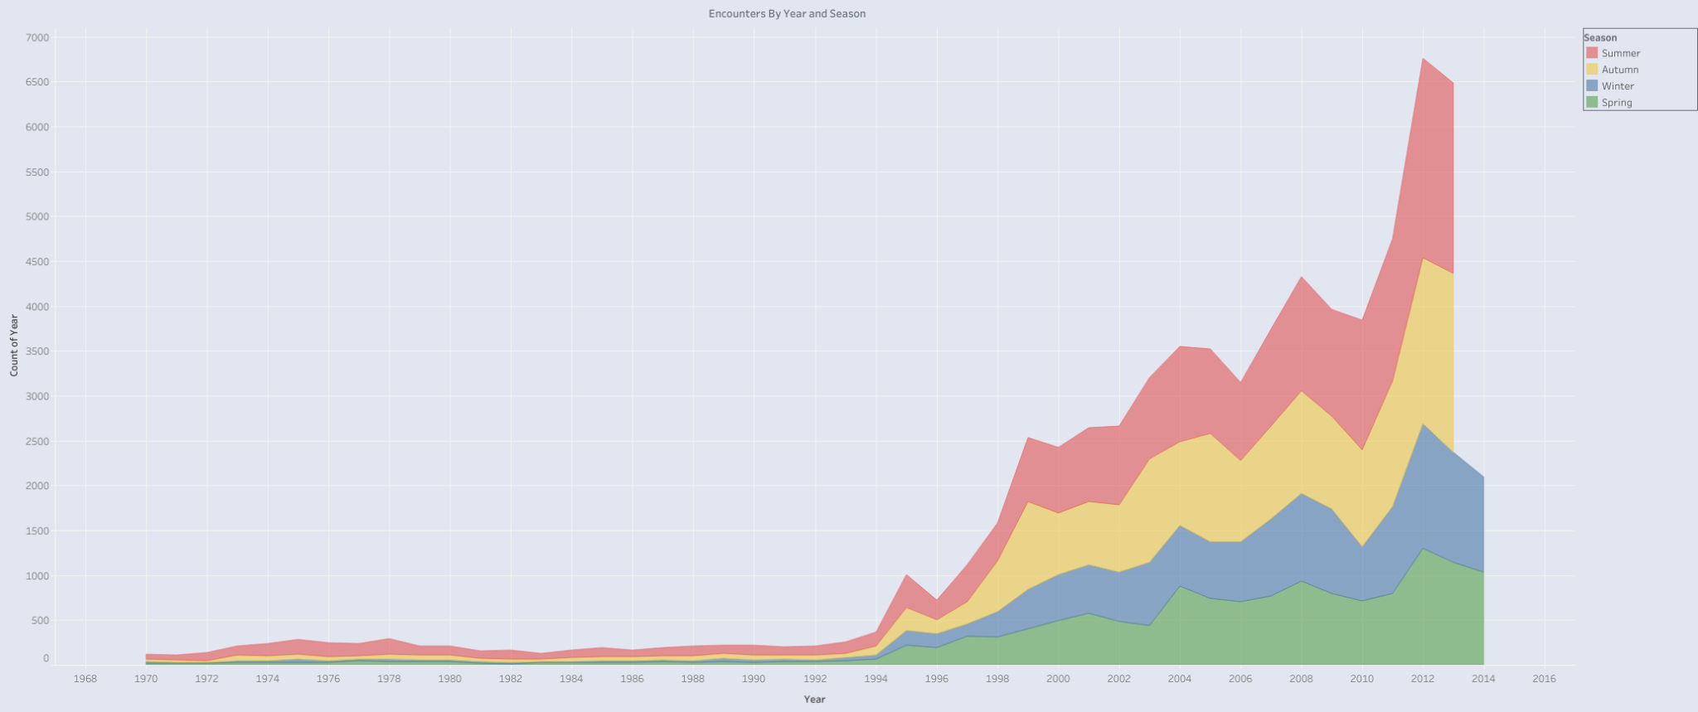
Time
Summer and Autumn
Late Evening: : 20:00 - 24:00
Reports Increasing

Slide 9
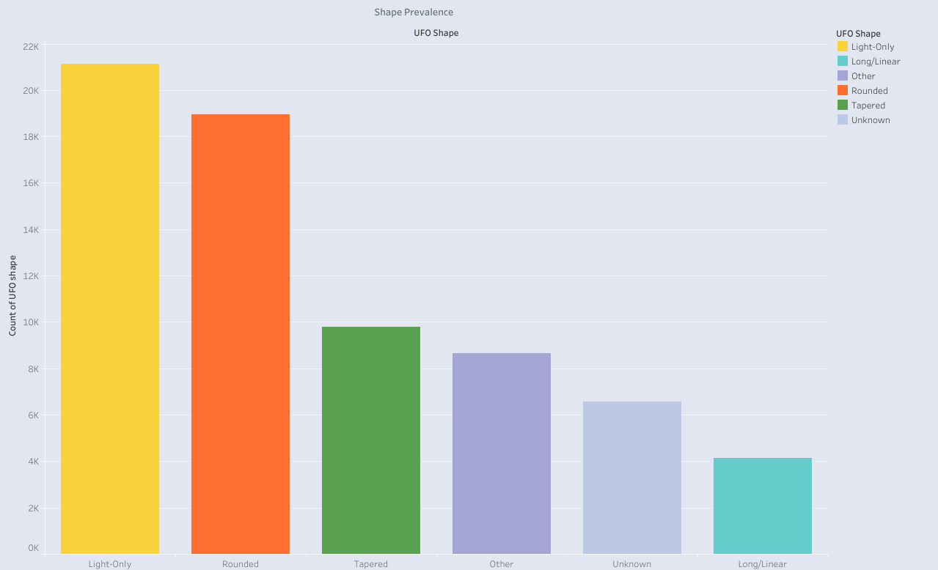
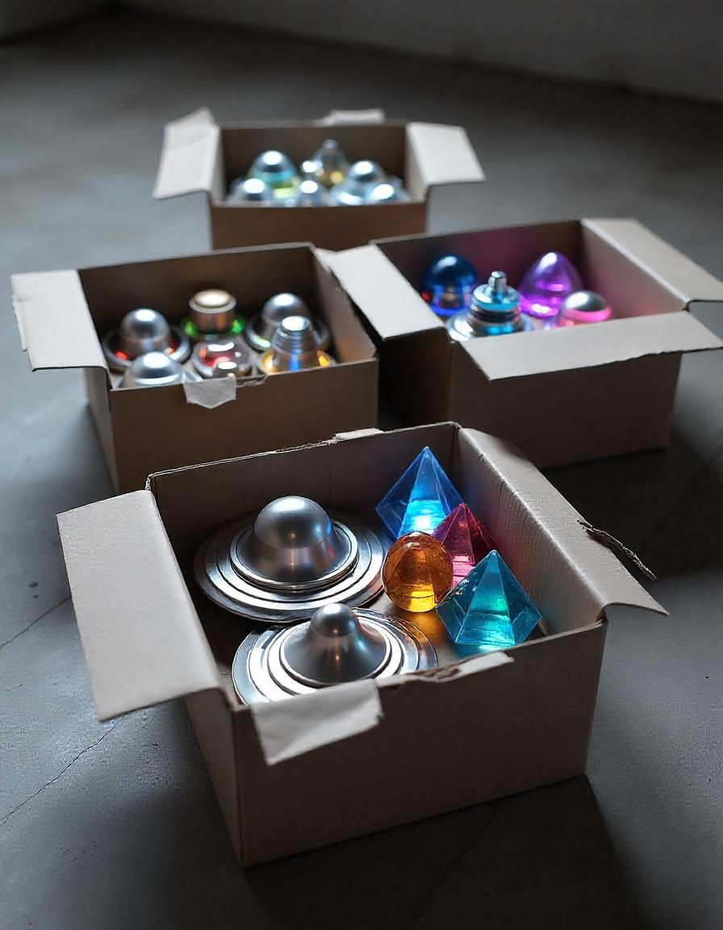
Shape
Sorted Shapes Into Simpler Categories

Slide 10
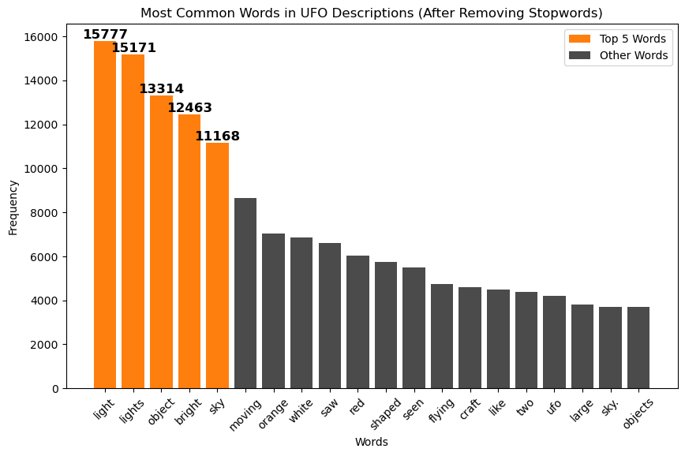
Description
1. “Light”,
2. “Lights”,
3. “Object”,
4. “Bright”,
5. “Sky”
6. “Moving”

Slide 11







Insights
Identifying Key Regions for Tourism
Timing Opportunities for Tour Experiences
Themed Experiences Based on UFO Shapes and Description

Slide 12
Next steps
Demographic
Sentiments
Weather

Slide 13



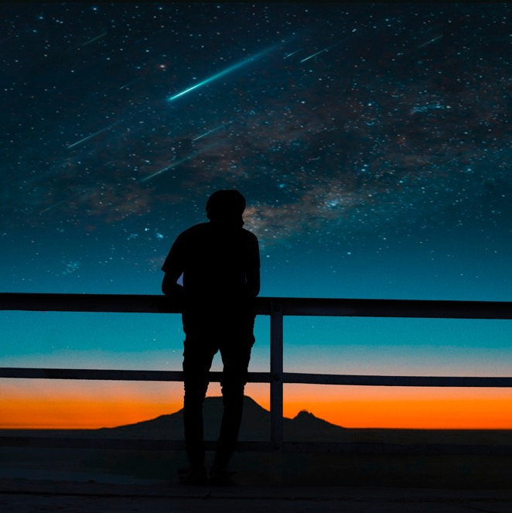

Conclusion
Our findings show how we can capitalize on both the Regions and Timing of UFO sightings to create unforgettable experiences.
Notes:
By focusing on the key areas, the right times of the year, and creating themed activities around what people are most likely to see, we can boost tourism and give visitors a truly out-of-this-world adventure.

Slide 14










flatiron@flatiron.com
Link to GitHub
Link to Tableu

